Slide 1
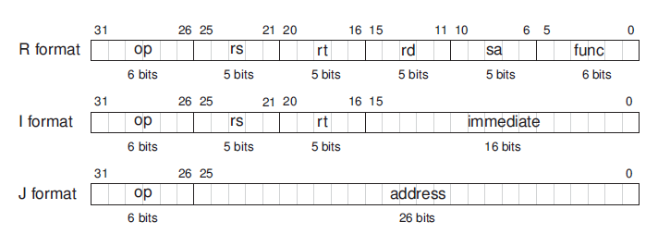
117

Slide 2
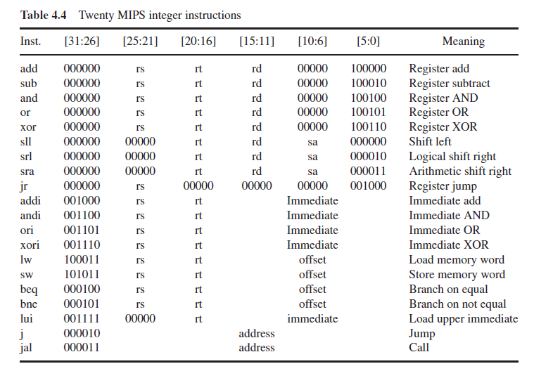
119

Slide 3
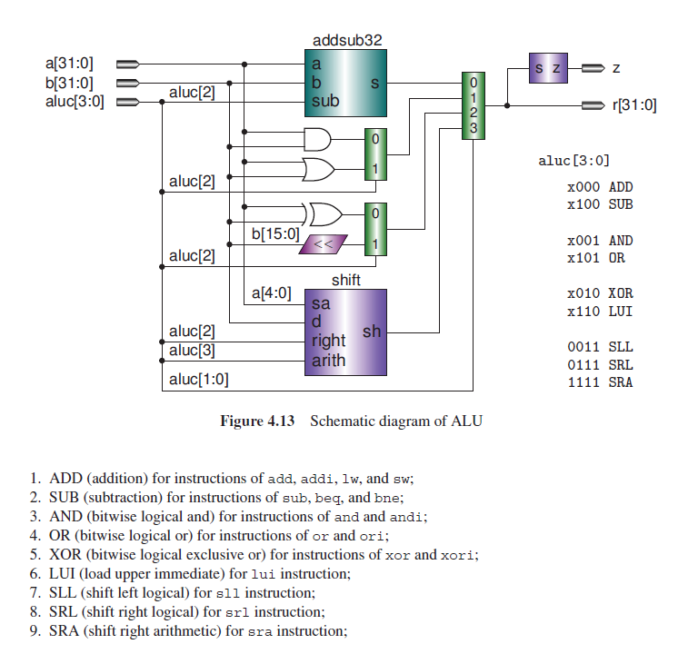
Notes:
137
The outputs of the ALU are a 32-bit r (result) and a 1-bit z (zero) flag. If the ALU result is 0, the zero flag will be a 1; otherwise it outputs a 0.

Slide 4
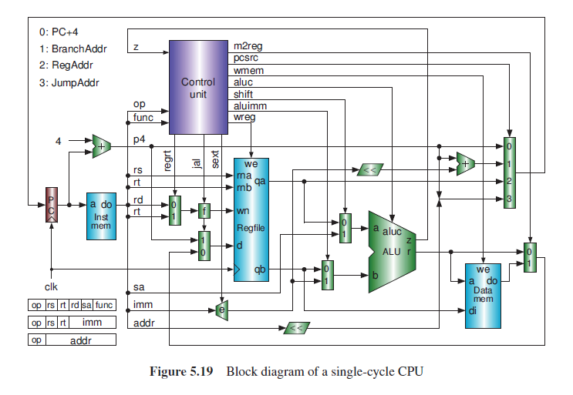
Single Clock CPU
Notes:
157

Slide 5
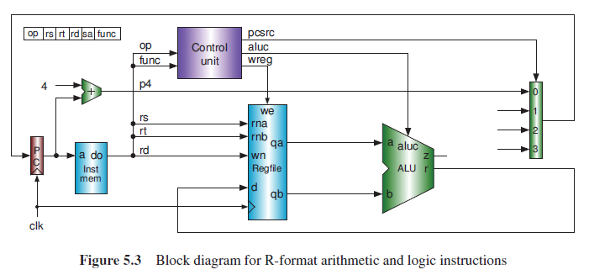
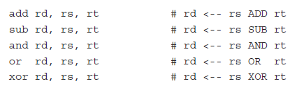


Slide 6
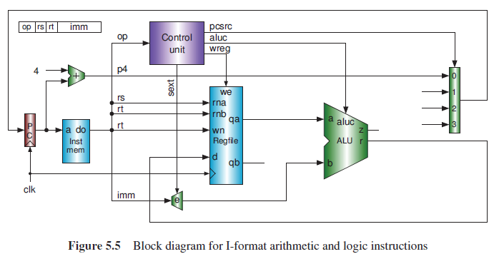
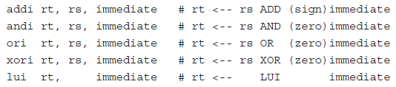

Slide 7
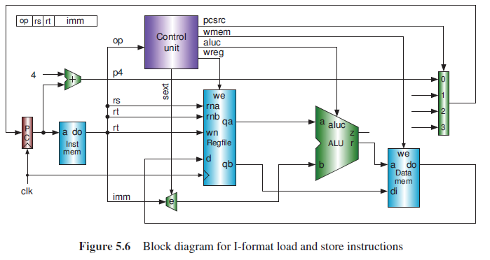


Slide 8
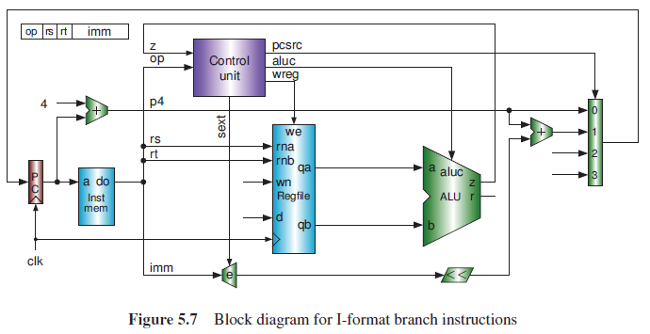
Notes:
The two operands in registers rs and rt are compared by the ALU. The result of the comparison z is
sent to the control unit to determine whether to branch or not. If the branch is taken, the 2-bit pcsrc signal
will be 01 to select the branch target address. An additional 32-bit adder is used to calculate the branch
target address, which is the sum of the PC+4 (p4 in the figure) and the 2-bit left-shifted sign-extended
immediate. These two instructions do not write the register file (wreg = 0).

Slide 9
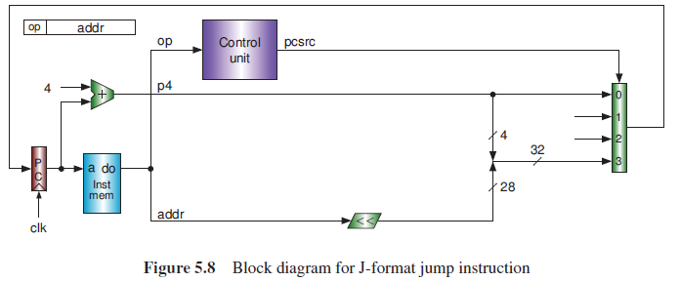
Notes:
This instruction uses neither the ALU nor the register file. The jump target address is obtained by the
concatenation of the high 4 bits of PC+4 and 2-bit left-shifted addr. pcsrc will be 11 to select the jump
target address.

Slide 10
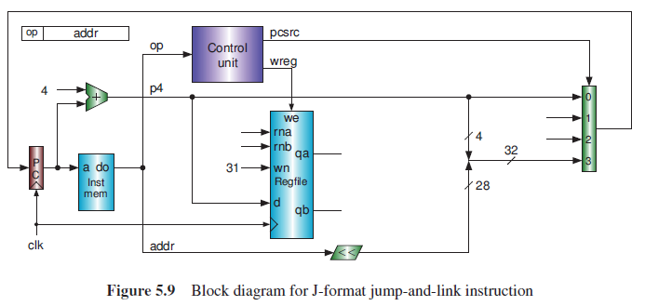
Notes:
the jal instruction saves the return address to register $31
of the register file. The number 31 does not appear in the instruction; we must create it by hardwire.

Slide 11
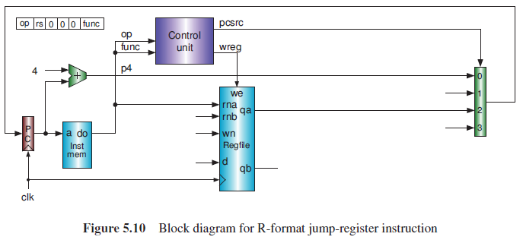

Notes:
The jump target address is obtained from register rs of the register file. pcsrc will be 10 to select the
jump target address.

Slide 12
Single Clock CPU
Notes:
157

Slide 13
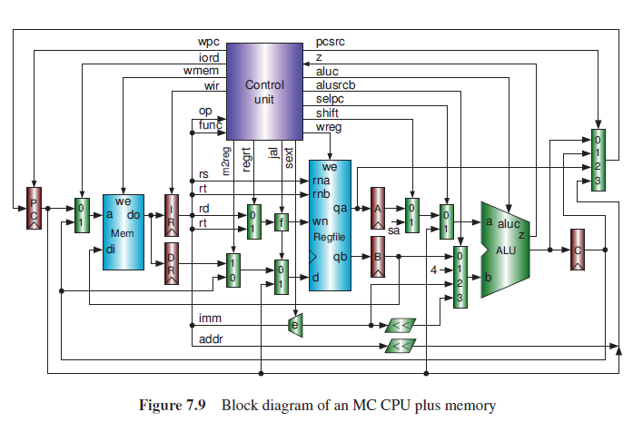
Multi Clock CPU
Notes:
199

Slide 14
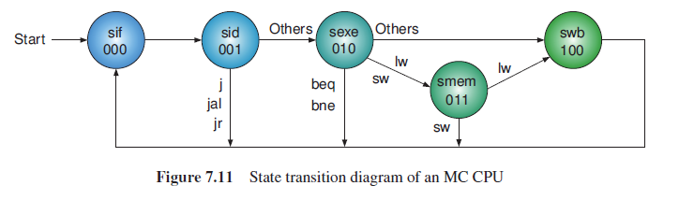
Control Unit State Machine
Notes:
202

Slide 15
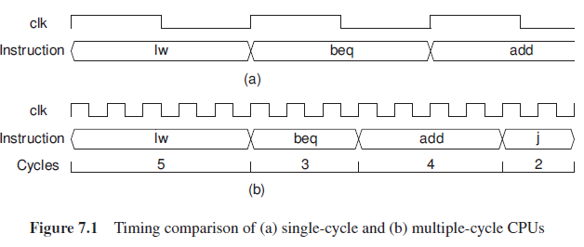
Notes:
193

Slide 16
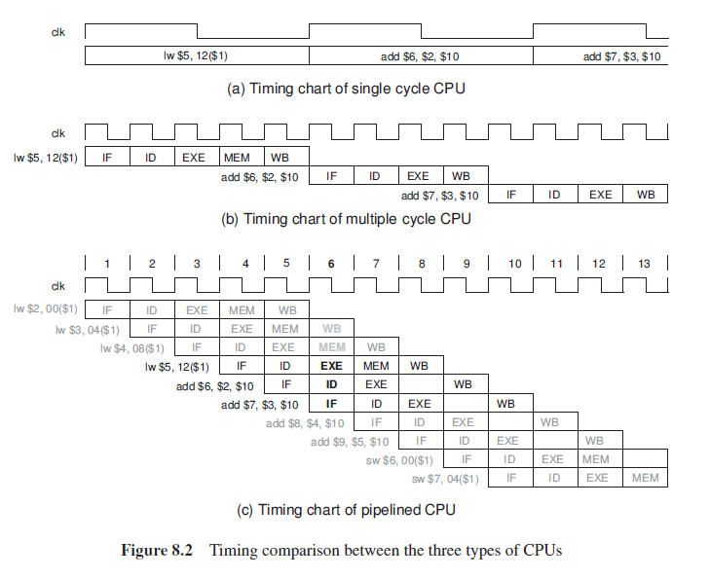

Slide 17
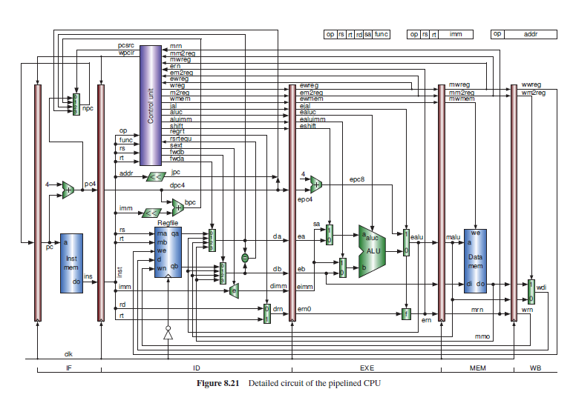
Pipelined CPU

